Slide 1

Know My Customer Agent
Copilot Scenario Overview
© 2026 Microsoft Corporation All rights reserved.
Notes:
CELA disclaimer
Terms displayed or discussed are for explanation/education only. Such terms may differ from your agreement.

Slide 2
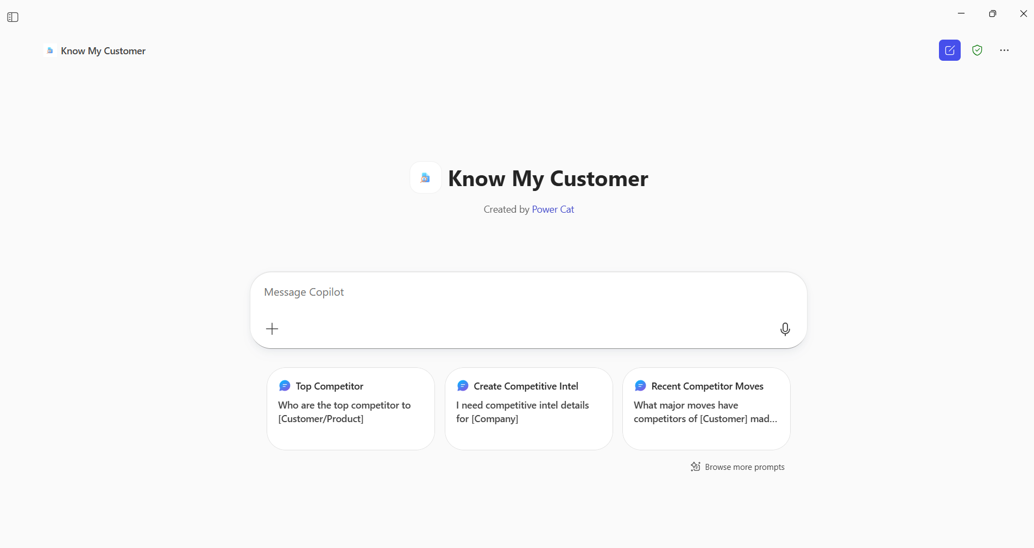
Know My Customer Agent Summary
Key Challenges
Agent Overview
Customer data is scattered over public websites
Manual, time‑consuming reviews with high operational risk
Inconsistent documentation
Difficulty identifying gaps and changes over time
This agent automates and standardizes customer research by consolidating customer data, documents, and risk signals into a single guided workflow — while keeping humans in control of final decisions.
Business Outcomes
😊 Faster customer onboarding and periodic reviews
⚙️ Reduced manual effort and operational risk
📊 Improved consistency, transparency, and readiness
📄 Generated a document report
Technical Features
📋 Rules‑driven customer research checklist generation by segment & jurisdiction
🔍 Automated gap analysis against documents and SharePoint folders
⚠️ Risk signal surfacing with explanations
📚 Guided next steps with references to policies and data sources
Notes:
CELA disclaimer
Terms displayed or discussed are for explanation/education only. Such terms may differ from your agreement.

Slide 3
Table of Contents
Overview
Persona Example
User Journey Scenario Example
Solution Screenshots
Demo Prompts
Notes:
CELA disclaimer
Terms displayed or discussed are for explanation/education only. Such terms may differ from your agreement.

Slide 4
The Know My Customer Agent helps teams enter customer conversations with a clear, shared understanding of who they’re engaging with, what’s already known, and where clarity is needed. Instead of piecing together context from scattered documents, systems, and prior interactions, users can ask the agent to summarize key customer attributes, surface gaps, and suggest relevant discussion points or follow‑up questions. The agent synthesizes available information into a structured, explainable view that supports more informed, confident conversations and better next steps.
Overview
© 2026 Microsoft Corporation All rights reserved.

Slide 5

Persona Example
The Agent empowers users to move from fragmented research to confident, well‑prepared customer conversations in a single interaction.
Sophie
Key Challenges
Account Executive / Seller
Addressed by the Know My Customer Agent
Prepares for customer and prospect meetings across industries and regions
Needs quick access to relevant customer context before calls or on‑site visits
Previously gathered information manually across CRM, slides, emails, notes, and public sources
Often entered meetings without a complete or up‑to‑date picture
Now uses the Know My Customer Agent to summarize what’s known, surface gaps, and suggest talking points and next steps
Customer information scattered across systems and documents, making prep slow and inconsistent
Limited time before meetings to build a clear customer narrative
Difficulty identifying what’s relevant vs. noise
Missed opportunities due to incomplete context or unclear next steps
Inconsistent customer understanding across account teams
💬Typical Ask
“Give me a quick overview of this customer before my meeting and highlight the key discussion points.”
“What do we know about this account and what should I focus on today?”

Slide 6

User Journey
The agent synthesizes customer context and available information to help users prepare for informed, relevant conversations with clear next steps.
1
Trigger
2
Evaluation
3
Assembly
4
Guided Output
Before a customer meeting or visit, the seller asks the agent to provide context on an account or contact.
For example :
“Help me prepare for my meeting with this customer.”
“What do we know about this account and what should I focus on today?”
The agent evaluates available customer context.
It identifies what’s known, what’s unclear, and what may be most relevant for the upcoming conversation.
Behind the scenes, the agent assembles everything into a single, structured view by:
Summarizing key customer context
Highlighting gaps or open questions
Surfacing relevant discussion points and signals
The seller receives a concise, structured briefing.
This enables confident, human‑led conversations supported by context, not guesswork.
Backbone
SharePoint KYC templates
Uploaded customer documents
Dataverse customer tracking
Public web knowledge

Slide 7



High Level Agent Architecture
Know My Customer Agent
Know my Customer Agent
SharePoint templates and reference libraries
Uploaded customer documents
Dataverse customer tracking table
Optional public web knowledge (for competitor analysis)
Output Structured briefing
Gap analysis
Guided recommendations
User
Trigger Example
User asks
““Help me prepare for my meeting with this customer.”

Slide 8
Agent Solution Screenshots
© 2026 Microsoft Corporation All rights reserved.
Notes:
Title: Click-through demo
Now, let’s see how that all comes together for our key persona.
CELA disclaimer
Terms displayed or discussed are for explanation/education only. Such terms may differ from your agreement.

Slide 9
Trigger
Notes:
CELA disclaimer Terms displayed or discussed are for explanation/education only. Such terms may differ from your agreement.

Slide 10
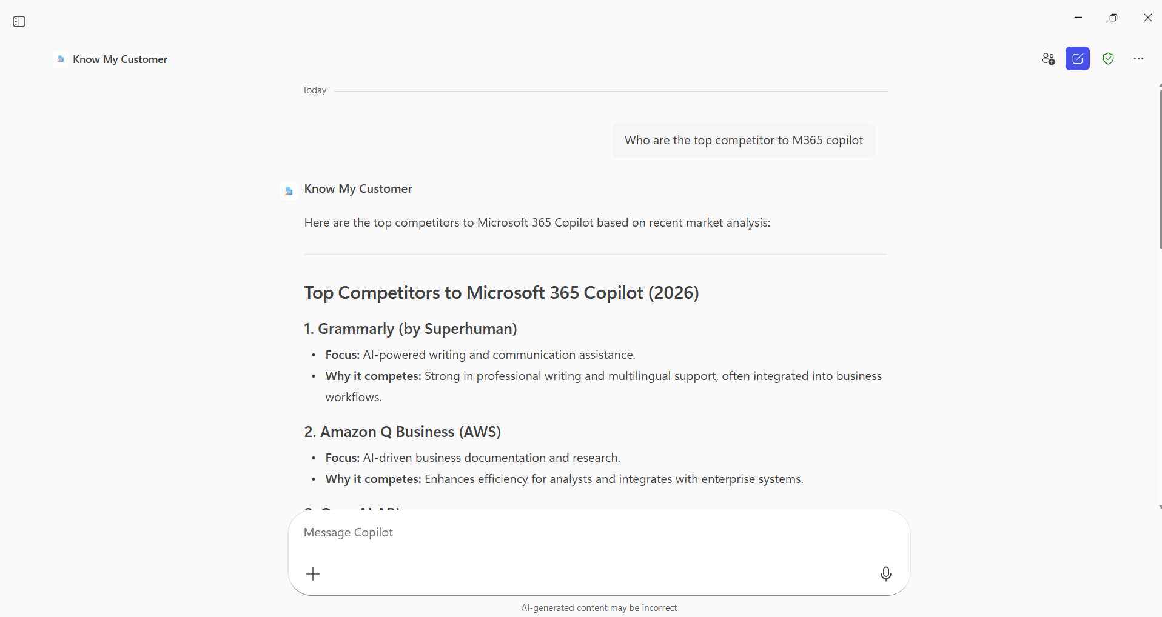
Output Example

Slide 11
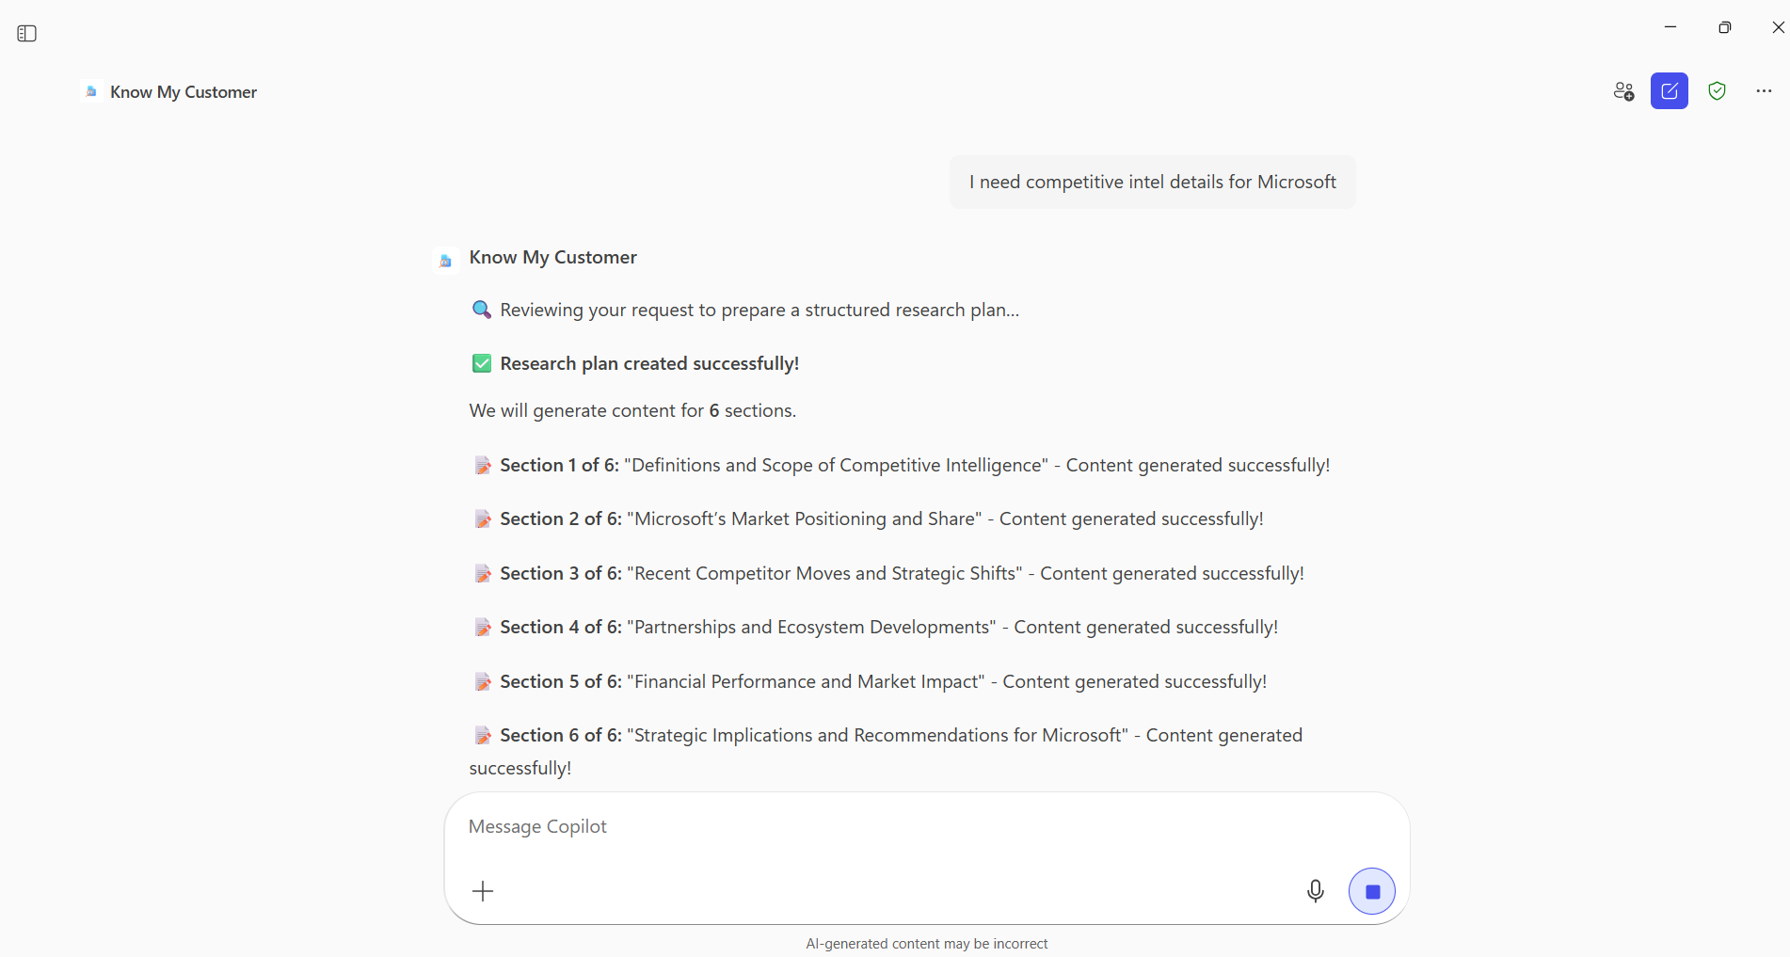
Output Example

Slide 12
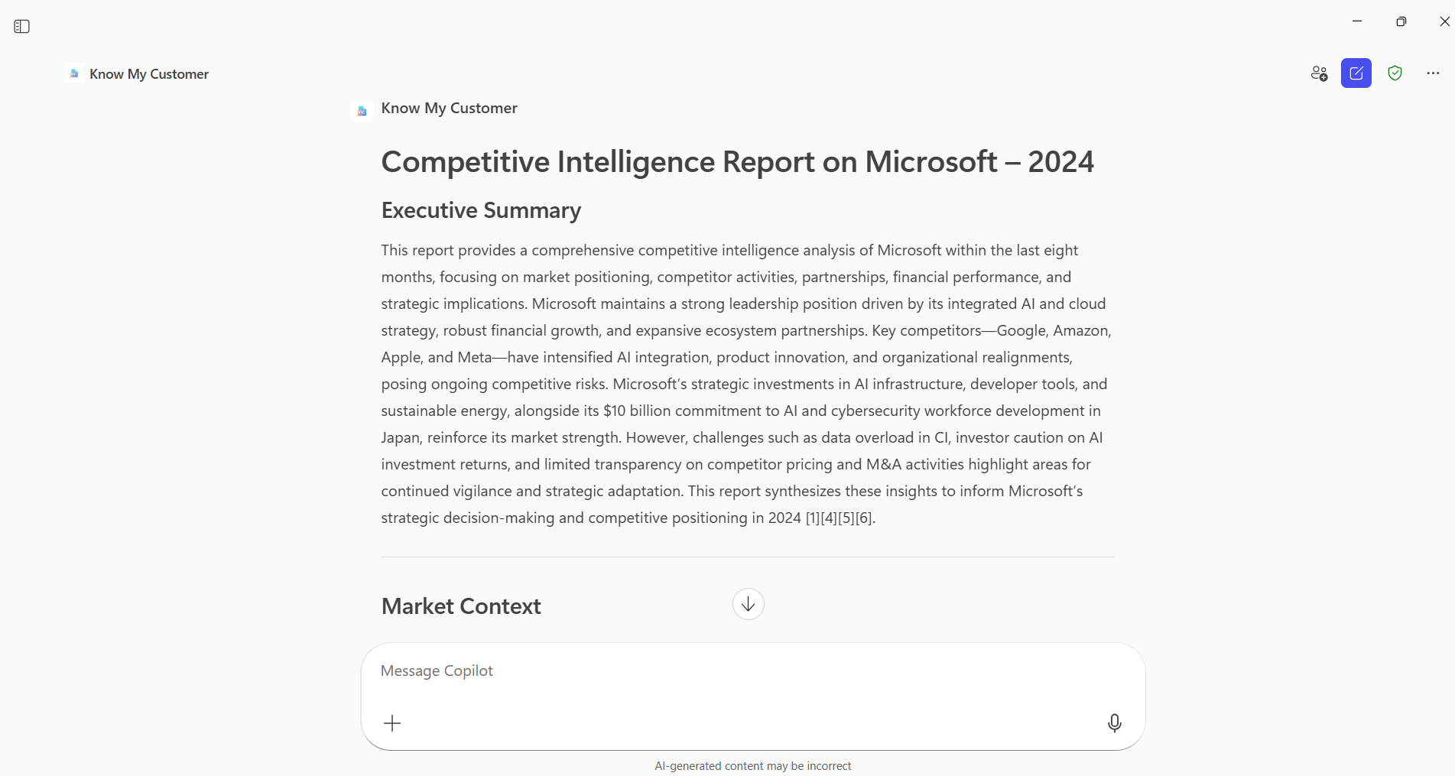
Output Example

Slide 13
Demo Prompts
© 2026 Microsoft Corporation All rights reserved.
Notes:
CELA disclaimer
Terms displayed or discussed are for explanation/education only. Such terms may differ from your agreement.

Slide 14
Demo Prompts
ID | Test Scenario | Prompt | Expected Result
1 | Customer Overview | “Give me a quick overview of Fabrikam Corp.” | Returns a concise customer snapshot: profile, industry, strategy themes, and recent signals.
2 | Relationship & Contacts | “Who do we typically engage with at this customer?” | Lists known contacts, roles, relationship context, and recent interactions.
3 | Recent Activity Summary | “What’s been happening with this customer recently?” | Summarises meetings, emails, notes, and recent changes or signals.
4 | Goals & Priorities Inference | “What does this customer seem to care about right now?” | Synthesises goals, initiatives, priorities, and challenges into a clear narrative.
5 | Knowledge Gaps Identification | “What don’t we know about this customer yet?” | Highlights missing context and suggests discovery questions.
6 | Conversation Preparation | “Help me prepare for my meeting with this customer.” | Produces a meeting‑ready brief: context, talking points, risks, and focus areas.
7 | Similar Customers / Patterns | “Have we seen similar situations with other customers like this?” | Surfaces comparable customers and relevant patterns or learnings.
8 | Document & Context Synthesis | “Summarise what our existing documents say about this customer.” | Aggregates insights from slides, notes, and shared documents into a single view.
9 | Opportunity Context | “Where might there be opportunities to help this customer?” | Identifies areas of potential value based on customer needs and signals.
10 | Customer Sensitivities | “Are there any sensitivities or things I should be careful about?” | Flags known concerns, constraints, or past friction points.
11 | Relationship Timeline | “How has our relationship with this customer evolved over time?” | Presents a high‑level engagement and relationship timeline.
12 | Account Health Signals | “How healthy does this customer relationship look?” | Synthesises engagement, momentum, and gaps into a qualitative health view.
13 | Competitor Landscape Awareness | “Who are the main competitors this customer works with?” | Surfaces known competitors, tools, vendors, or alternatives mentioned in context.
14 | Competitive Positioning Context | “Where do we differentiate compared to what this customer already uses?” | Highlights relevant differentiators tied to the customer’s priorities and competitor context.
15 | Competitor‑Driven Conversation Prep | “What questions should I ask given their current vendor landscape?” | Suggests smart, neutral discovery questions informed by competitor signals.

Slide 15
Thank You
Notes:
CELA disclaimer
Terms displayed or discussed are for explanation/education only. Such terms may differ from your agreement.

